Slide 1

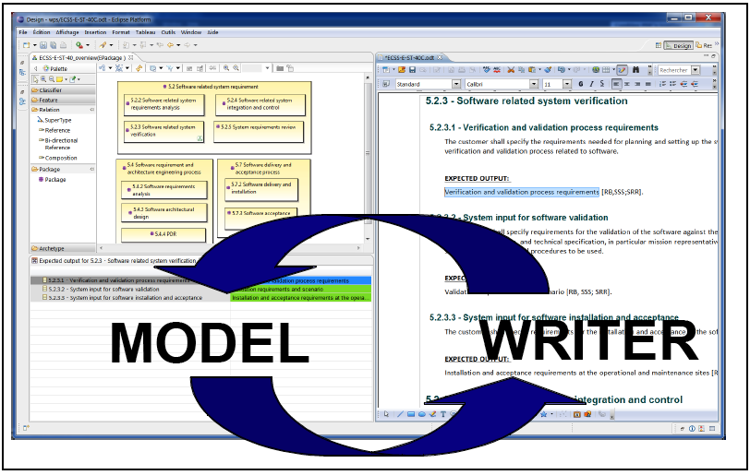
ModelWriter Text & Model-Synchronized Document Engineering Platform
Project Leader: Ferhat Erata (ferhat@computer.org)
Project Email: project@modelwriter.eu
Notes:
I’d like to begin by thanking you all for coming today.
My name is [Ferhat Erata] from [UNIT Information Technologies Research & Development].
I am the project leader of ModelWriter project.
Before starting the presentations, I would like to invite review chairman to make the introductory speech for today’s review.
The graphics on this slide is a mock-up that shows what was envisioned before starting off the project. This demonstrates two aspects of ModelWriter. At the RHS is the writer part and at LHS is the model part. If you look at the details, the synchronization is maintained behind the scene.
1

Slide 2
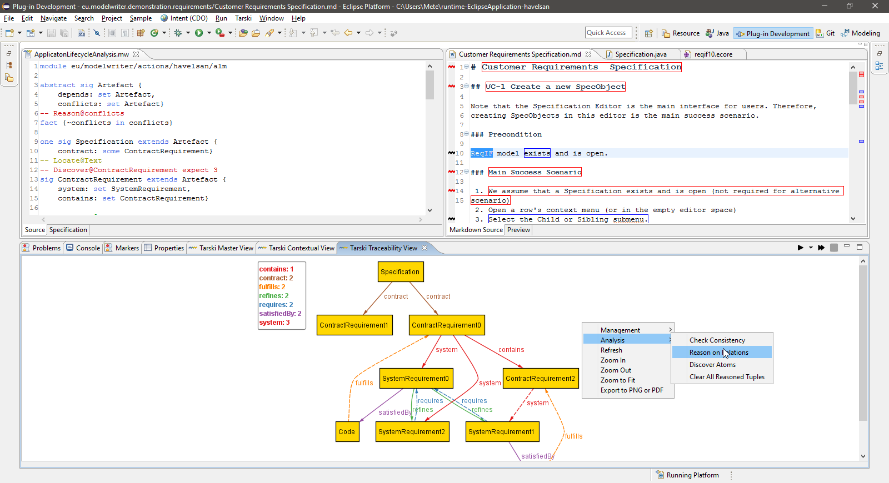
ModelWriter Text & Model-Synchronized Document Engineering Platform
Project Leader: Ferhat Erata (ferhat@computer.org)
Project Email: project@modelwriter.eu
Notes:
The latter one, this one, clearly shows that we achieved the goal of having a working User Interfaces on Eclipse platform. That was what we anticipated. In addition to that, we provide a view at the bottom to visualize the those traceability links between artefacts or part of artefacts.
2

Slide 3
1 Introduction
Ferhat Erata
UNIT, ModelWriter Project Leader
Notes:
Let me introduce the partners attends today’s meeting. I have already introduced myself.
Let’s begin with CNRS/LORIA, Prof. Claire, could you introduce yourself and your research organization…
3

Slide 4








Participants ModelWriter #1 Review
Ferhat Erata
Dr. Moharram Challenger
Hasan Emre Kirmizi
Yvan Lussaud
Etienne Juliot
Dr. Eray Tuzun
Yagup Macit
Tuğçe Yiğiter
Alan Endersoy
Dr. Emrah Kinav
Dr. Guven Köse
Omurhan Soysal
Aydin Can Polatkan
Dr. Claire Gardent
Dr. Samuel Cruz-Lara
Dr. Bikash Gyawali
Anastasia Shimorina
Dr. Geylani Kardas
Mehmet Onat
Hale Gezgen
Ersan Gürdoğan
Taskin Kızıl
Oguz Yavuz
Dr. Anne Monceaux
Notes:
Let me introduce the partners attends today’s meeting. I have already introduced myself.
Let’s begin with CNRS/LORIA, Prof. Claire, could you introduce yourself and your research organization…
I would like to specially thank Anne for hosting the meeting, to Vincent for his mentorship.
4

Slide 5
Agenda [13:00 - 17:00]
Introduction (5 mins) [13:00 - 13:05]
Overview of the project (WP5) (15 min) [13:05 - 13:20]
Industrial Use Cases (WP1) (30 min) [13:20 - 13:50]
Exploitation Related Activities (WP7) (10 mins) [13:50 - 14:00]
Technical Innovations (WP2, 3 & 4) (30 mins) [14:00 - 14:30]
User Interfaces & Integration (WP6) (10 mins) [14:30 - 14:40]
Break (20 mins) [14:40 - 15:00]
Demonstrations (60 mins) [15:00 - 16:00]
Conclusions (10 mins) [16:00 - 16:10]
Reviewers’ Private Section (30 min) [16:10 - 16:40]
Feedback Session (15min) [16:40 - 16:55]
Final Words (5 min) [16:55 - 17:00]
Notes:
We’ve planned an intense schedule for today. Presentation is divided into 5 main sections.
First I will make an overview of the project.
Second, Anne from Airbus will moderate the industrial use cases segment. Based on your feedbacks made after the first review, we made a decision to focus on the most rewarding use cases that are stemmed from the problems faced by our large industrial partners. Therefore, Airbus, Ford-Otosan and Havelsan will present their use cases. In each use case, we will describe Technical Challenges and corresponding KPIs.
Third, once you get familiar with the problem domain, we will explain the market of ModelWriter and our exploitation prospects.
Fourth, we’ll describe technical achievements attained for each technical work package, which means will focus on innovations in this section. What we accomplished beyond the SotA and innovations in tackling the challenges. We will try to convince you that ModelWriter is an effective remedy for this set of problems.
Finally, we will demonstrate what we achieved in the industrial use cases. We will make three demonstrations for Airbus, Havelsan and Ford Otosan.

